Slide 1
Application: Tin Sulfide Photovoltaics
Device architecture and parameters of interest:
Model:
SCAPS (a Solar Cell Capacitance Simulator), software developed at the University of Gent
https://scaps.elis.ugent.be/
Ag
ITO
ZnO
Zn(O,S)
S_{eff}, ΔE_{c}
SnS
µ, τ
Mo
SiO₂
R. E. Brandt, R. C. Kurchin, et al. Joule 2017, 1(4), 843.

Slide 2
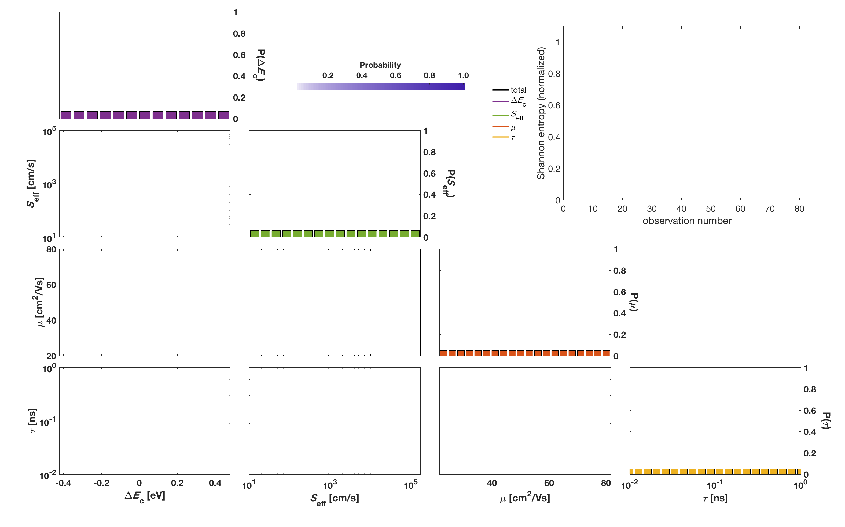
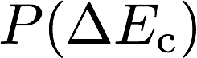
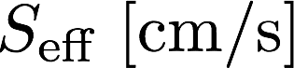
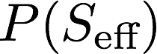
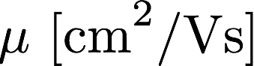
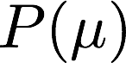
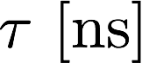
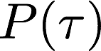
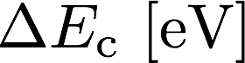
4D probability distributions are gnarly!
Ag
ITO
ZnO
Zn(O,S)
S_{eff}, ΔE_{c}
SnS
µ, τ
Mo
SiO₂
Probability
R. E. Brandt, R. C. Kurchin, et al. Joule 2017, 1(4), 843.

Slide 3
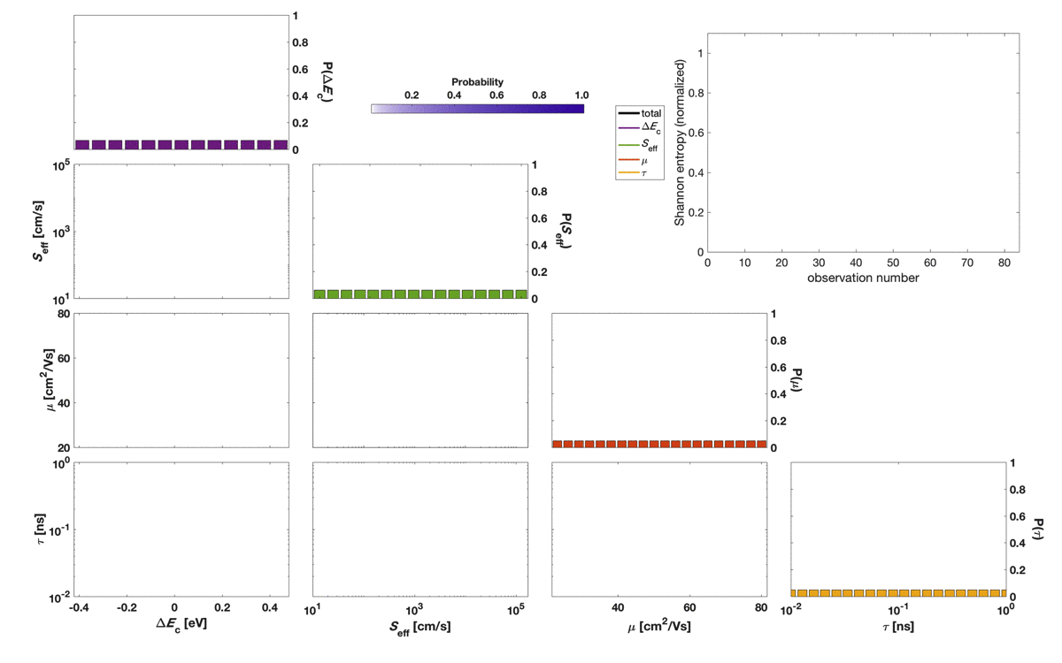
Feed me data!
Probability
R. E. Brandt, R. C. Kurchin, et al. Joule 2017, 1(4), 843.

Slide 4
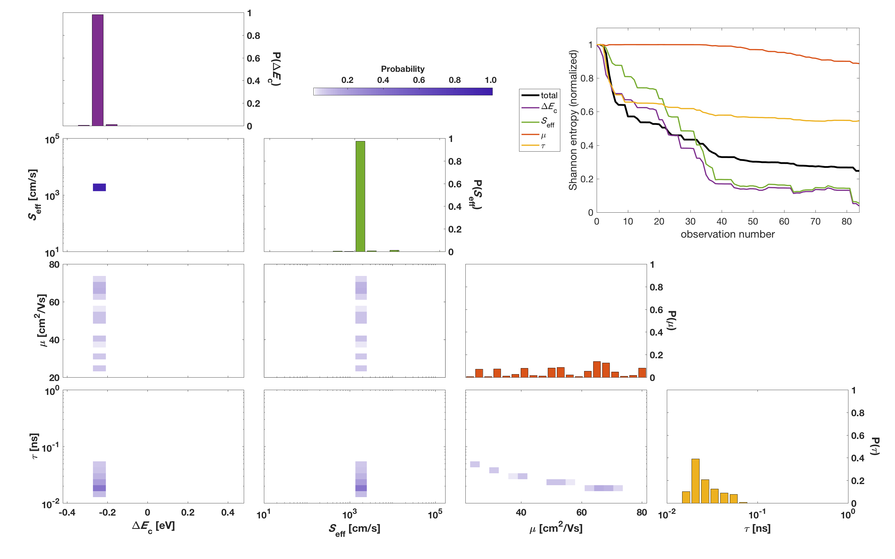
Let’s step through it
??? ???
Probability
R. E. Brandt, R. C. Kurchin, et al. Joule 2017, 1(4), 843.

Slide 5
Another application! (still solar cells)
fitting parameters
functions of experimental conditions (ill., T)
Measuring these parameters is hard!
W. Shockley and W. Read. Phys. Rev. 1952, 87(46), 835.
R. N. Hall. Phys. Rev. 1952, 87(2), 387.
R. C. Kurchin et al. . IEEE JPV 2020, 10(6), 1532.

Slide 6
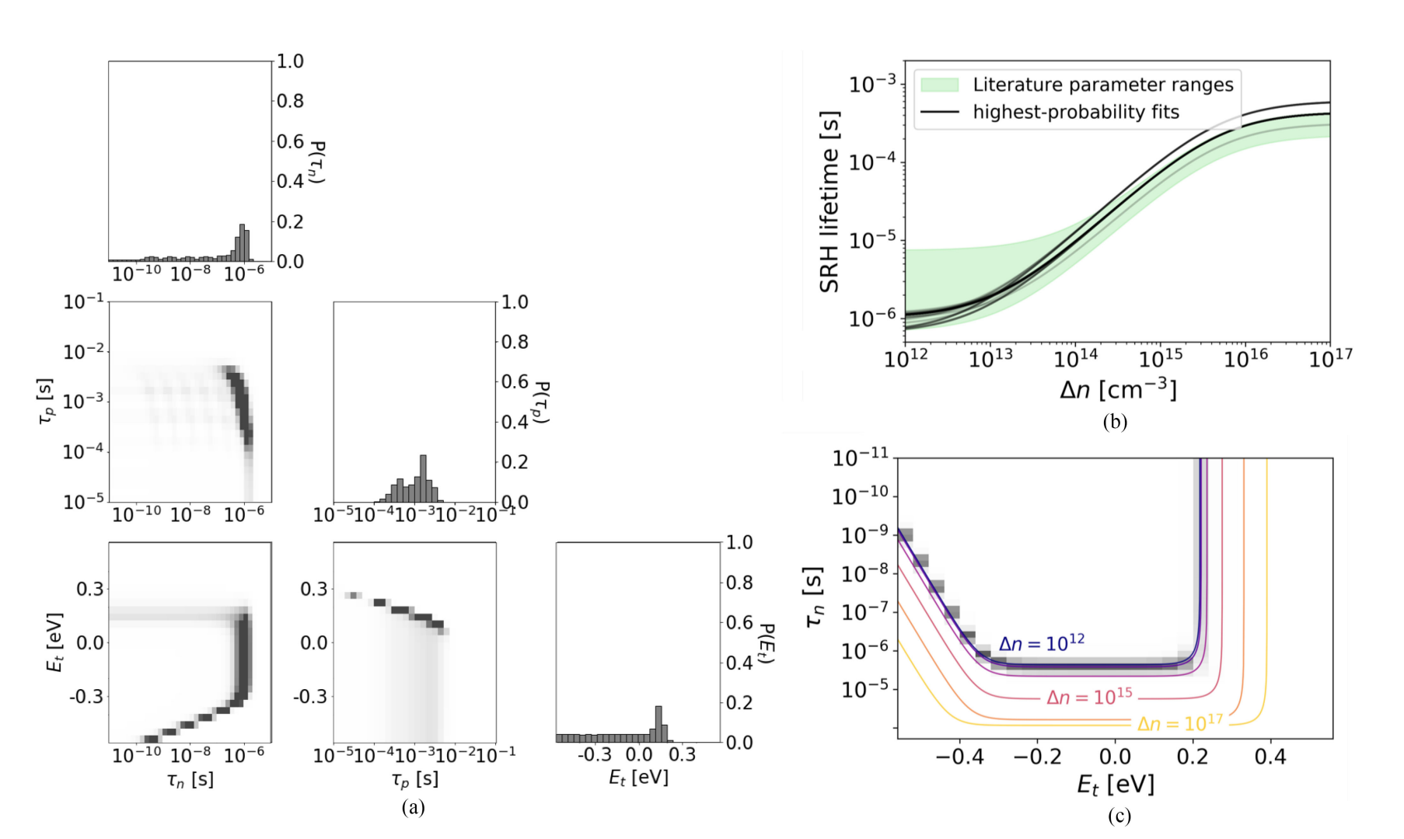
Fe in Si results
R. C. Kurchin, et al. IEEE JPV 2020, 10(6), 1532.

Slide 7
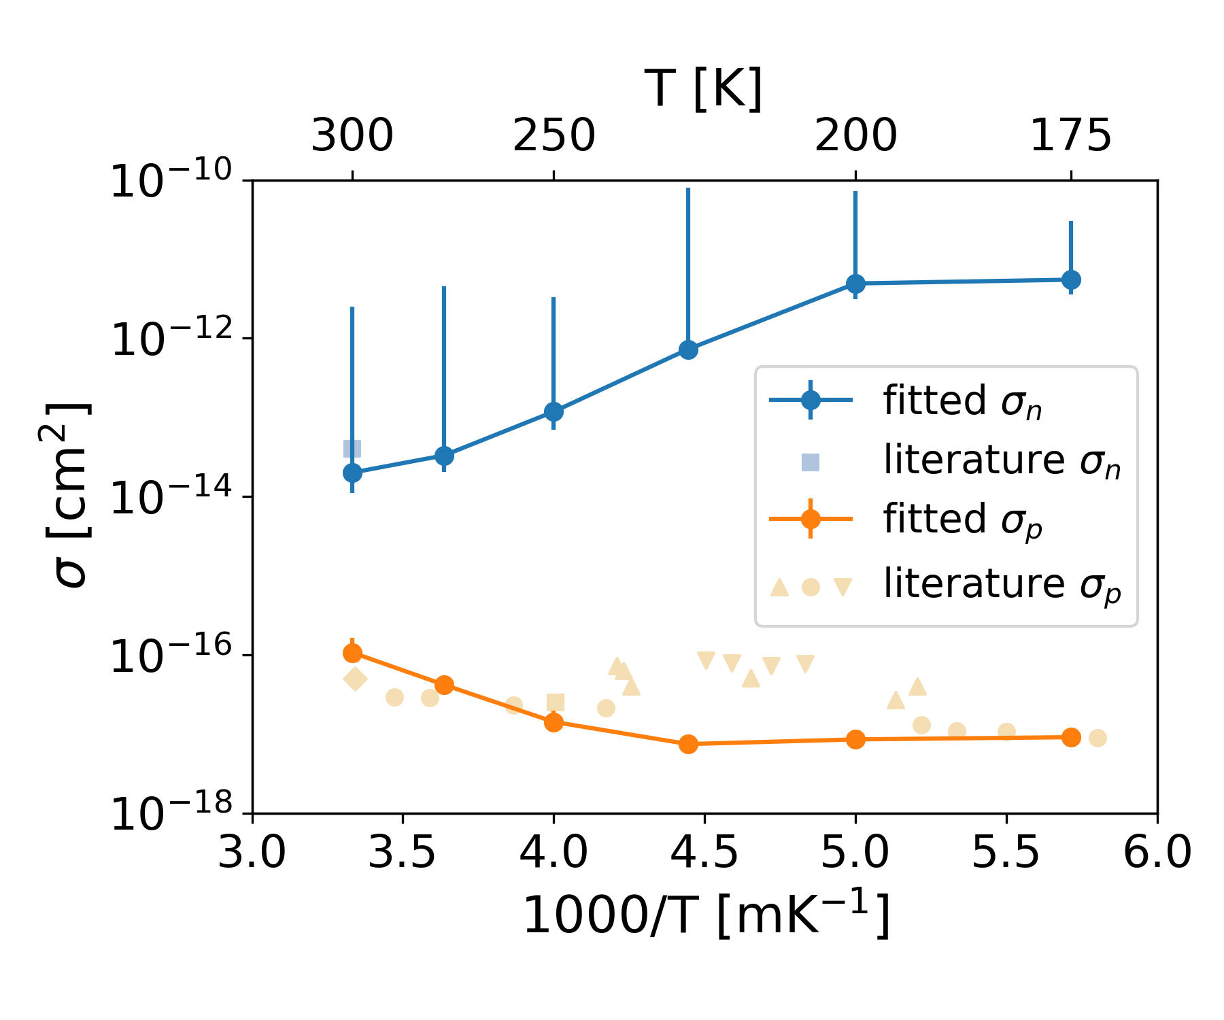
Fe in Si results (continued)
R. C. Kurchin, et al. IEEE JPV 2020, 10(6), 1532.

